Slide 1

Database Design
DAVID M. KROENKE and DAVID J. AUER
DATABASE CONCEPTS, 7th Edition, Global Edition
Chapter Five

Slide 2
Chapter Objectives
Learn how to transform E-R data models into relational designs
Practice applying the normalization process
Understand the need for denormalization
Learn how to represent weak entities with the relational model
Know how to represent 1:1, 1:N, and N:M binary relationships

Slide 3
Chapter Objectives (Cont’d)
Know how to represent 1:1, 1:N, and N:M recursive relationships
Learn SQL statements for creating joins over binary and recursive relationships

Slide 4
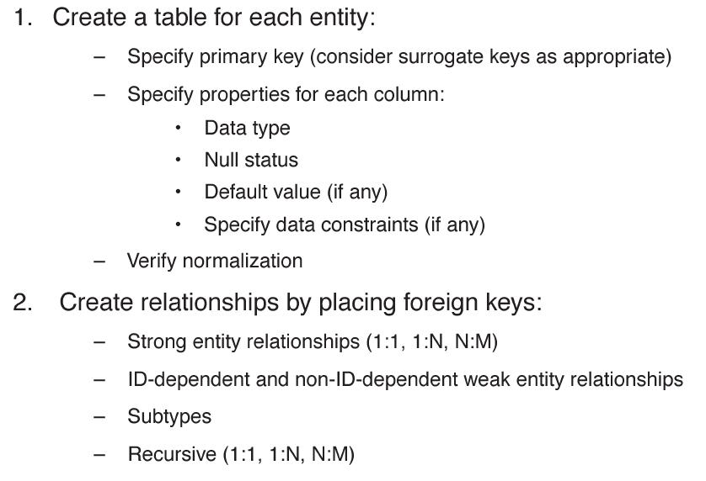
Transforming a Data Model into a Relational Design

Slide 5
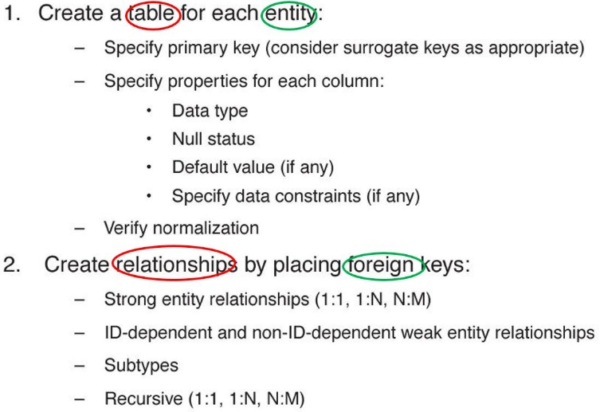
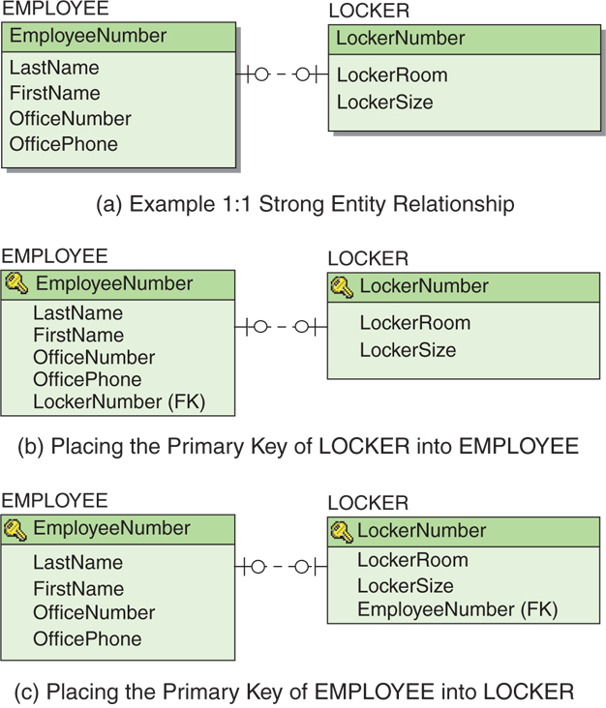
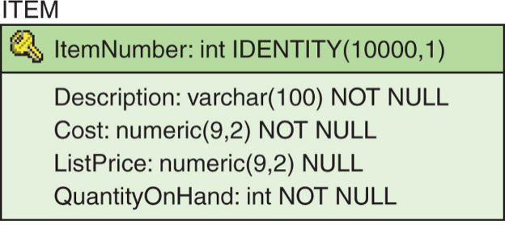
Transforming a Data Model into a Relational Design

Slide 6
Representing Entities with the Relational Model
Create a relation for each entity.
A relation has a descriptive name and a set of attributes that describe the entity.
Specify a primary key.
Specify column properties:
Data type
Null status
Default values (if any)
Data constraints (if any)
The relation is then analyzed using the normalization rules.
As normalization issues arise, the initial relation design may need to change.

Slide 7
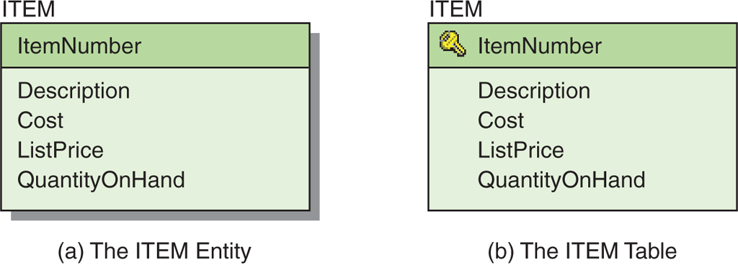
Representing an Entity as a Table
ITEM (ItemNumber, Description, Cost, ListPrice, QuantityOnHand)
Figure 5-2: The ITEM Entity and Table

Slide 8
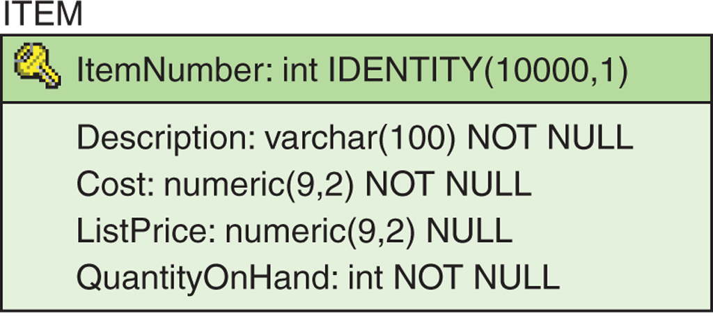
The Entity Table with Column Characteristics
ITEM (ItemNumber, Description, Cost, ListPrice, QuantityOnHand)
Figure 5-3: The Final ITEM Table

Slide 9
Normalization Review: Modification Problems
Tables that are not normalized will experience issues known as modification problems.
Insertion problems
Difficulties inserting data into a relation
Modification problems
Difficulties modifying data into a relation
Deletion problems
Difficulties deleting data from a relation

Slide 10
Normalization Review: Solving Modification Problems
Most modification problems are solved by breaking an existing table into two or more tables through a process known as normalization.

Slide 11
Normalization Review: Definition Review
Functional dependency
The relationship (within the relation) that describes how the value of one attribute may be used to find the value of another attribute.
Determinant
The attribute that can be used to find the value of another attribute in the relation
The left-hand side of a functional dependency

Slide 12
Normalization Review: Definition Review II
Candidate key
The value of a candidate key can be used to find the value of every other attribute in the table.
A simple candidate key consists of only one attribute.
A composite candidate key consists of more than one attribute.

Slide 13
Normalization Review: Normal Forms
There are many defined normal forms:
First Normal Form (1NF)
Second Normal Form (2NF)
Third Normal Form (3NF)
Boyce-Codd Normal Form (BCNF)
Fourth Normal Form (4NF)
Fifth Normal Form (5NF)
Domain/Key Normal Form (DK/NF)

Slide 14
Normalization Review: Normalization
For our purposes, a relation is considered normalized when:
Every determinant is a candidate key.
[Technically, this is Boyce-Codd Normal Form (BCNF)]

Slide 15
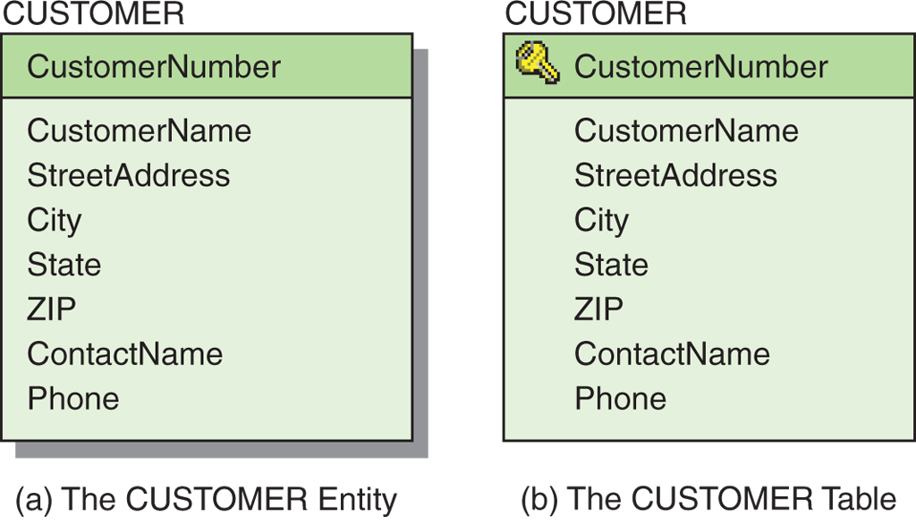
The CUSTOMER Table
CUSTOMER (CustomerNumber, CustomerName, StreetAddress,
City, State, ZIP, ContactName, Phone)
ZIP→(City, State)
ContactName→Phone
Figure 5-4: The CUSTOMER Entity and Table

Slide 16
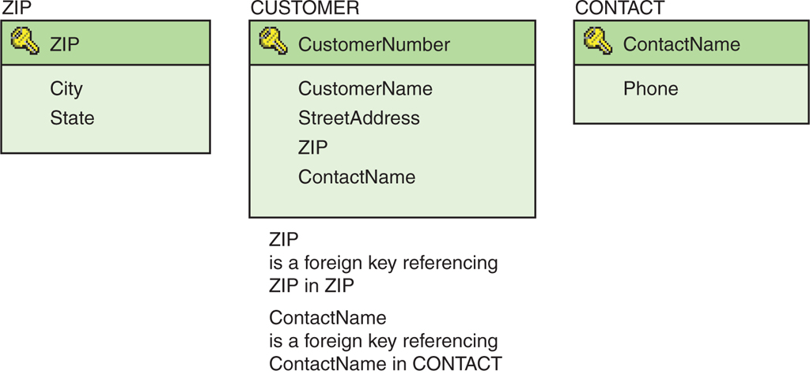
The CUSTOMER Entity: The Normalized Set of Tables
CUSTOMER (CustomerNumber, CustomerName, StreetAddress,
ZIP, ContactName)
ZIP (ZIP, City, State)
CONTACT (ContactName, Phone)
Figure 5-5: The Normalized CUSTOMER and Associated Tables

Slide 17
Denormalization
Normalizing relations (or breaking them apart into many component relations) may significantly increase the complexity of the data structure.
The question is one of balance.
Trading complexity for modification problems
There are situations where denormalized relations are preferred.
Notes:
She traded her posters for his CD. 그녀는 자기 포스터를 그의 시디와 교환했다
Trading complexity for modification problems
(정규화로 인한) complexity 증가 대신에 modification 문제를 안고 가겠다.
substitute butter by margarine [by 교환주체] (=substitute margarine for butter) (for 교환객체) 버터 대신에 마가린을 쓰다. substitute electric for horse traction 말의 힘으로 끌던 것을 전기로 바꾸다. substitute an experiment for a theory 이론을 실험으로 대치하다. New computers are being substituted for the old. 낡은 컴퓨터를 새 것으로 교체하고 있는 중이다. erase a word and substitute another 한 단어를 지우고 다른 단어를 대신 넣다.

Slide 18
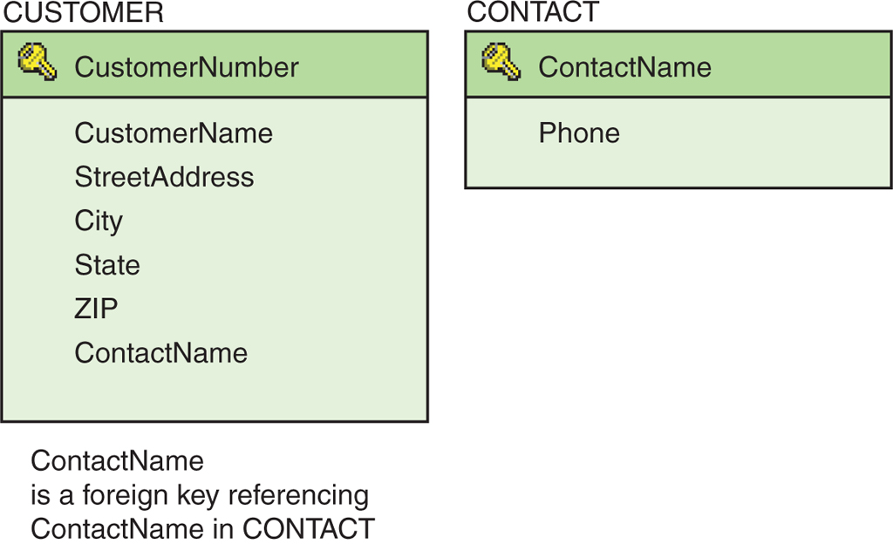
The CUSTOMER Entity: The Denormalized Set of Tables
CUSTOMER (CustomerNumber, CustomerName, StreetAddress,
City, State, ZIP, ContactName)
CONTACT (ContactName, Phone)
Figure 5-6: The Denormalized CUSTOMER and Associated CONTACT Tables

Slide 19
Representing Weak Entities
If not ID-dependent, use the same techniques as for strong entities.
If ID-dependent, then must add primary key of the parent entity.

Slide 20
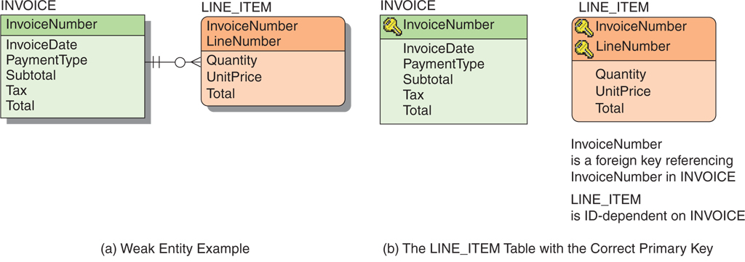
Representing Weak Entities Example
Figure 5-9: Relational Representation of a Weak Entity

Slide 21
Representing Relationships 1:1 Relationships
The maximum cardinality determines how a relationship is represented.
1:1 relationship
The key from one relation is placed in the other as a foreign key.
It does not matter which table receives the foreign key.

Slide 22
Representing Relationships 1:1 Relationship Example
Figure 5-10: 1:1 Strong Entity Relationships

Slide 23
Representing Relationships SQL for 1:1 Relationships
SELECT *
FROM LOCKER, EMPLOYEE
WHERE LOCKER.LockerNumber =
EMPLOYEE.LockerNumber;
SELECT *
FROM LOCKER, EMPLOYEE
WHERE LOCKER.EmployeeNumber =
EMPLOYEE.EmployeeNumber;

Slide 24
Representing Relationships 1:N Relationships
Like a 1:1 relationship, a 1:N relationship is saved by placing the key from one table into another as a foreign key.
However, in a 1:N the foreign key always goes into the many-side of the relationship.
The 1 side is called the parent.
The N side is called the child.
Notes:
However, in a 1:N the foreign key always goes into the many-side of the relationship.
∵ 자료 저장 Field 에 값 1개만 들어갈 수 있기 때문이다.

Slide 25
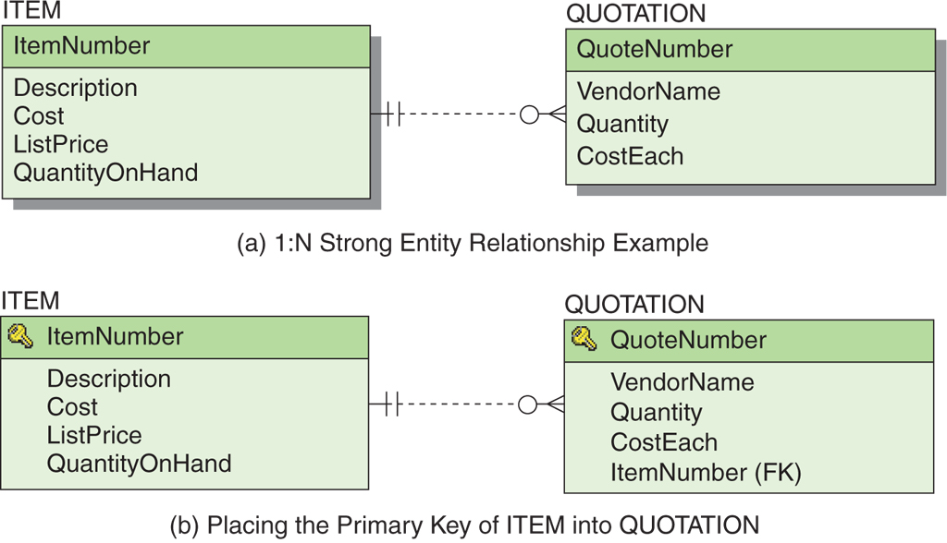
Representing Relationships 1:N Relationship Example
Figure 5-12: 1:N Strong Entity Relationships

Slide 26
Representing Relationships SQL for 1:N Relationships
SELECT *
FROM ITEM, QUOTATION
WHERE ITEM.ItemNumber =
QUOTATION.ItemNumber;

Slide 27
Representing Relationships N:M Relationships
To create an N:M relationship, a new table is created. This table is called an intersection table.
An intersection table has a composite key consisting of the keys from each of the tables that it connects.

Slide 28
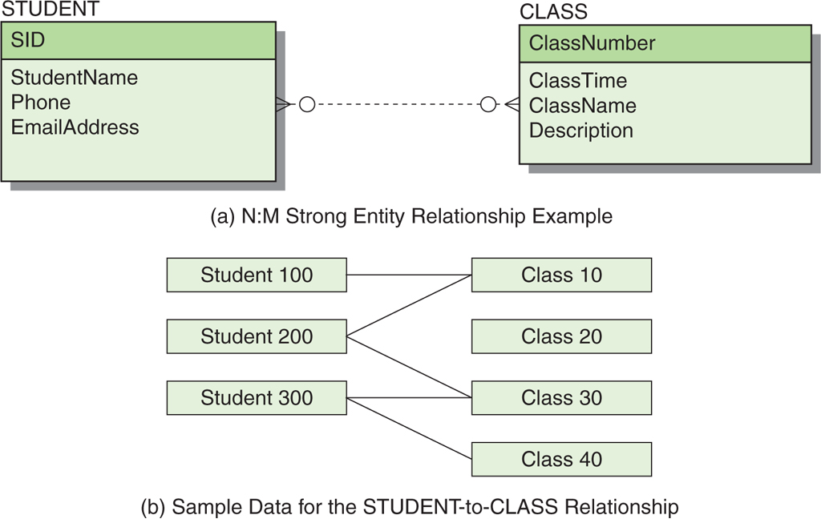
Representing Relationships N:M Relationship – Data Model
Figure 5-13: N:M Strong Entity Relationships

Slide 29
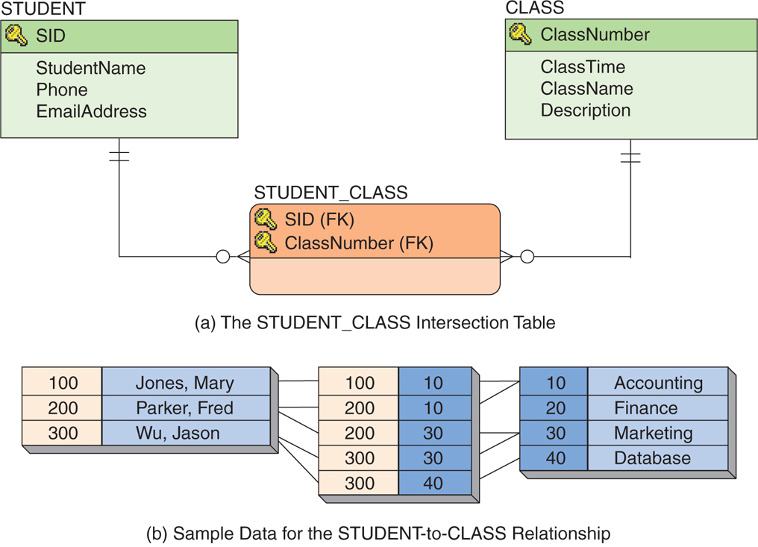
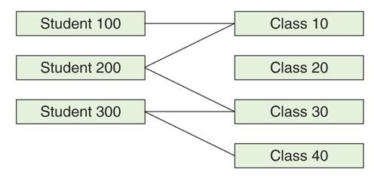
Representing Relationships N:M Relationship – Database Design
Figure 5-15: Representing an N:M Strong Entity Relationship

Slide 30
Representing Relationships SQL for N:M Relationships
SELECT *
FROM STUDENT, CLASS, STUDENT_CLASS
WHERE STUDENT.SID = STUDENT_CLASS.SID
AND STUDENT_CLASS.ClassNumber = CLASS.ClassNumber;

Slide 31
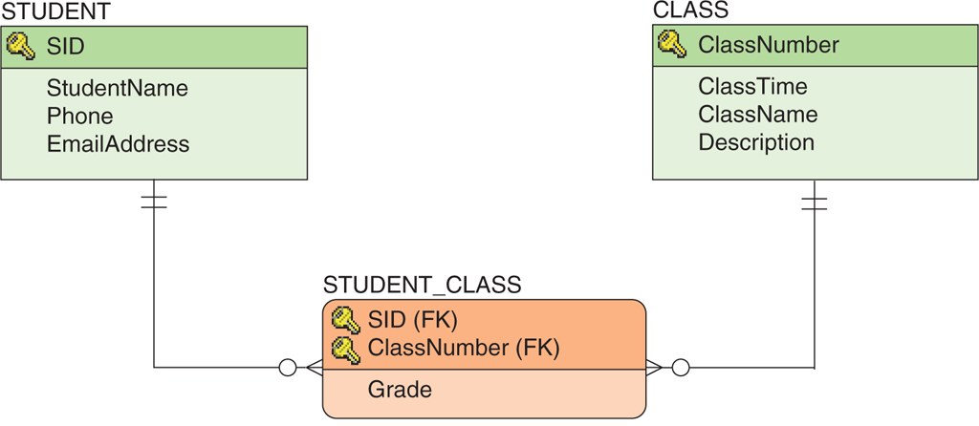
Representing Relationships Association Relationships
When an intersection table has columns beyond those in the primary key, the relationship is called an association relationship.
Figure 5-18: The Association Relationship

Slide 32
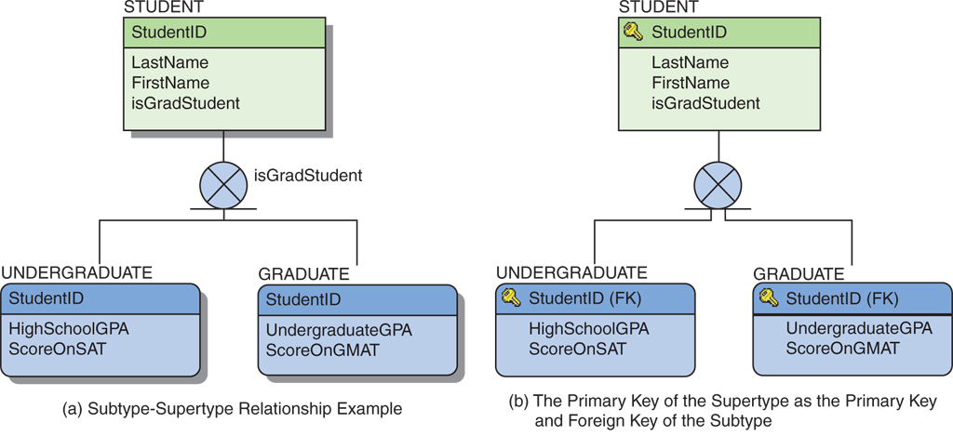
Representing Relationships Supertype/Subtype Relationships
The identifier of the supertype becomes the primary key and the foreign key of each subtype.
Figure 5-20: Representing Subtypes

Slide 33
Representing Relationships Recursive Relationships
A recursive relationship is a relationship that a relation has with itself.
Recursive relationships adhere to the same rules as binary relationships.
1:1 and 1:M relationships are saved using foreign keys.
M:N relationships are saved by creating an intersecting relation.

Slide 34
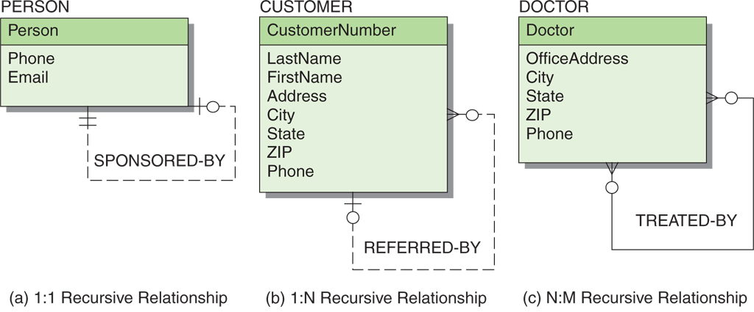
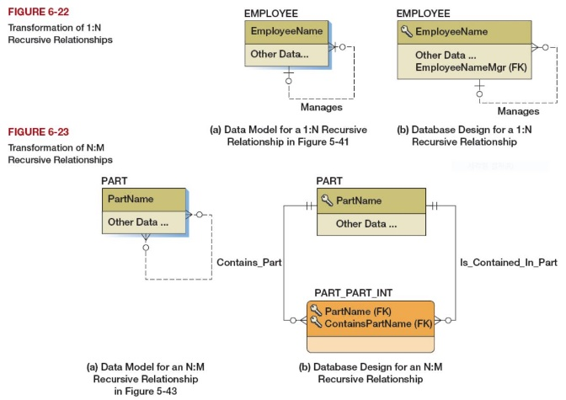
Representing Relationships Recursive Relationships—Examples
Zero
dashed line: 교정
Figure 5-21: Example Recursive Relationships
Notes:
N:M Recursive Relationships The trick for representing N:M recursive relationships is to decompose the N:M relationship into two 1:N relationships. We do this by creating an intersection table, just as we did for N:M relationships between strong entities. [Database Processing (15th Ed.) p.291]

Slide 35
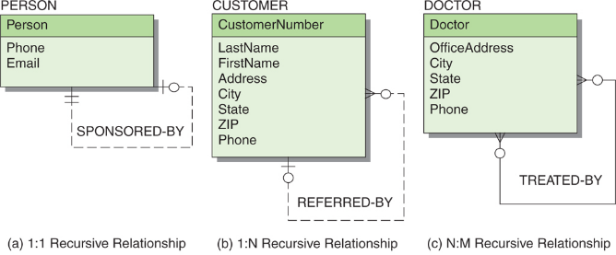

Representing Relationships Recursive Relationships—Examples
Zero
Figure 5-21: Example Recursive Relationships
Notes:
N:M Recursive Relationships The trick for representing N:M recursive relationships is to decompose the N:M relationship into two 1:N relationships. We do this by creating an intersection table, just as we did for N:M relationships between strong entities. [Database Processing (15th Ed.) p.291]

Slide 36
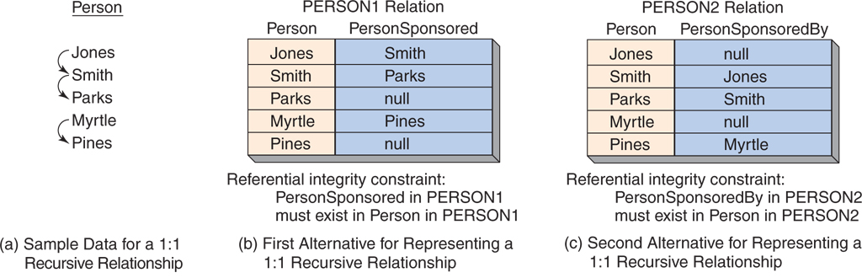
Representing Relationships 1:1 Recursive Relationship Examples
sponsor
Smith
Jones
SELECT *
FROM PERSON1 AS A, PERSON1 AS B
WHERE A.Person = B.PersonSponsored;
SELECT *
FROM PERSON2 AS C, PERSON2 AS D
WHERE C.Person = D.PersonSponsoredBy;
Figure 5-22: Example 1:1 Recursive Relationships
Notes:
spon·sor [ |spɑːnsə(r) ] 1. 보증인(surety) (for). 2. 대부[대모](godparent) ; (진수<進水>하는 배의) 명명자. 3. …의 보증인이 되다, 보증하다.
표 PERSON1의 크기: “행의 개수” = “Person 명수”

Slide 37
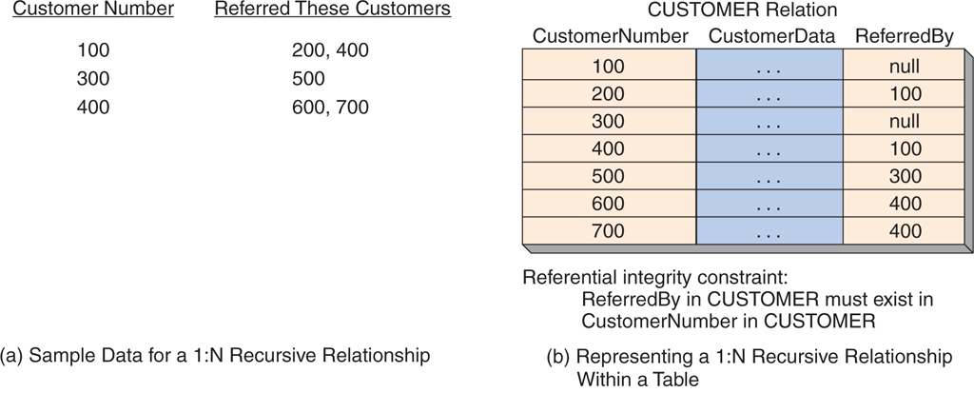
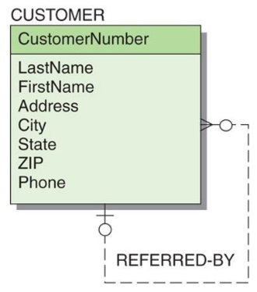
Representing Relationships 1:N Recursive Relationship Example
SELECT *
FROM CUSTOMER AS A, CUSTOMER AS B
WHERE A.CustomerNumber = B.ReferredBy;
Figure 5-23: Example 1:N Recursive Relationship

Slide 38
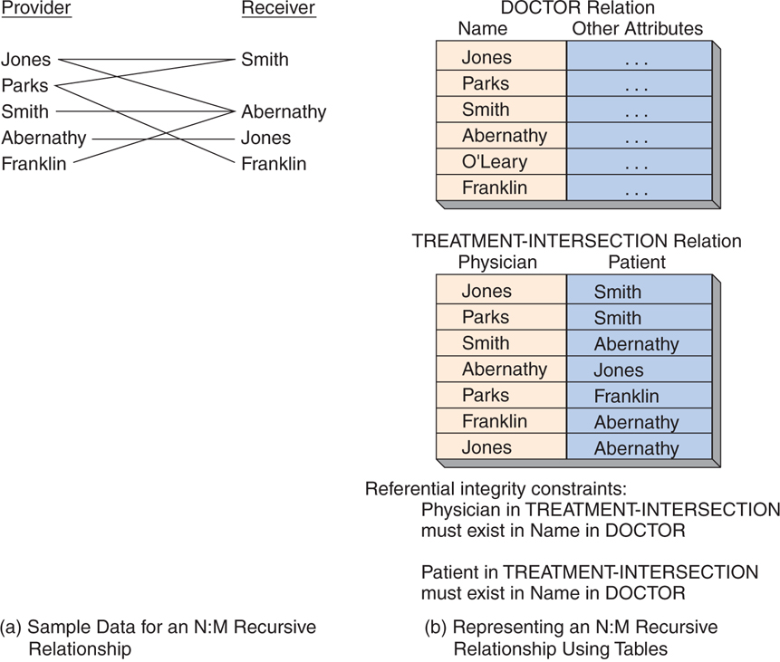
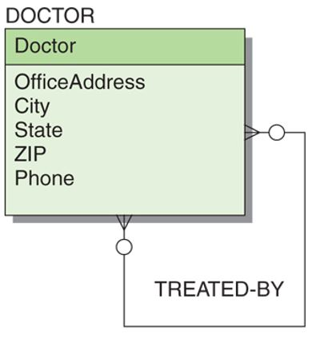
Representing Relationships N:M Recursive Relationship Example
dashed line: 교정
Figure 5-24: Example of an N:M Recursive Relationship
Notes:
N:M Recursive Relationships The trick for representing N:M recursive relationships is to decompose the N:M relationship into two 1:N relationships. We do this by creating an intersection table, just as we did for N:M relationships between strong entities. [Database Processing (15th Ed.) p.291]

Slide 39
SQL for N:M Recursive Relationships
SELECT *
FROM DOCTOR AS A,
DOCTOR AS B,
TREATMENT-INTERSECTION
WHERE A.Name = TREATMENT-INTERSECTION.Physician
AND TREATMENT-INTERSECTION.Patient = B.Name;

Slide 40
Heather Sweeney Designs: Developing a Database Design
Heather Sweeney Designs will be used as on ongoing example throughout Chapters 4, 5, 6, 7, and 8.
Heather Sweeney is an interior designer who specializes in home kitchen design.
She offers a variety of free seminars at home shows, kitchen and appliance stores, and other public locations.
She earns revenue by selling books and videos that instruct people on kitchen design.
She also offers custom-design consulting services.

Slide 41
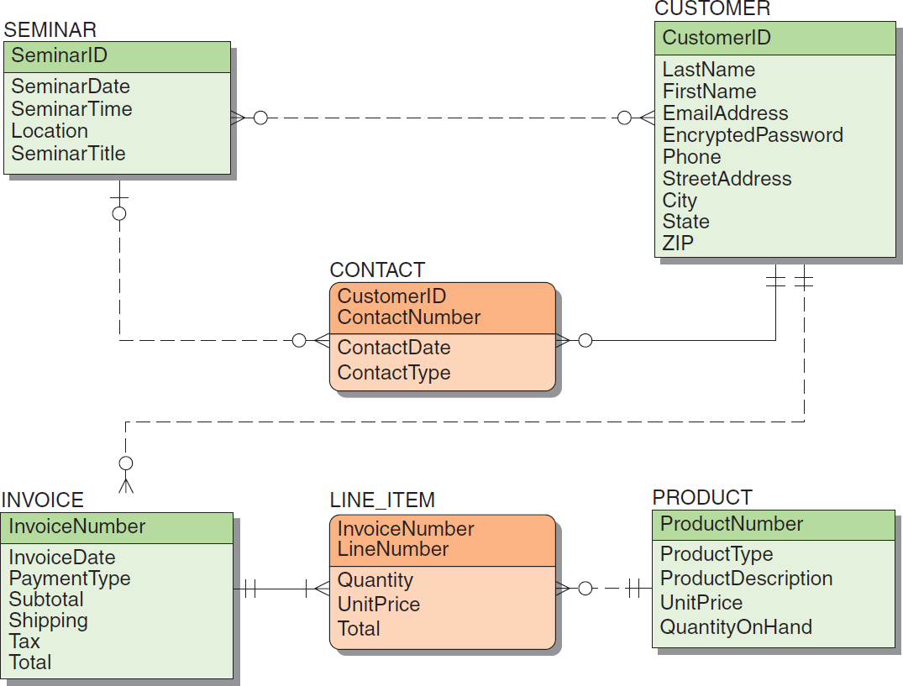
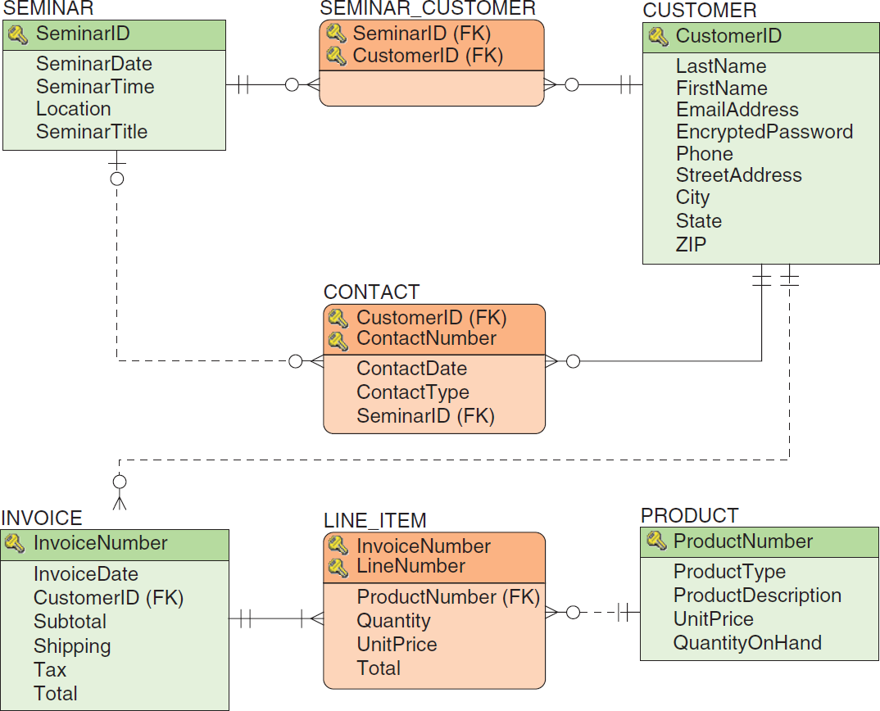
Heather Sweeney Designs: Final Data Model
Figure 5-27: Database Design for Heather Sweeney Designs
Figure 5-25: The Final Data Model for Heather Sweeney Designs
Notes:
교정: 그림 5-27 INVOICE entity 안에 PaymentType attribute를 추가해야 함

Slide 42
Specifying Column Properties
Column properties must be specified for each table.
The finalized column properties for the HSD tables are on the next set of slides
these are the column characteristics after additional needed foreign keys (shown in bold) have been added
This includes any new intersection tables.
Considering the relationships in this diagram, 1:N relationships exist between
SEMINAR and CONTACT, between CUSTOMER and INVOICE, and between PRODUCT and LINE_ITEM
For each of these, we place the key of the parent in the child as a foreign key

Slide 43
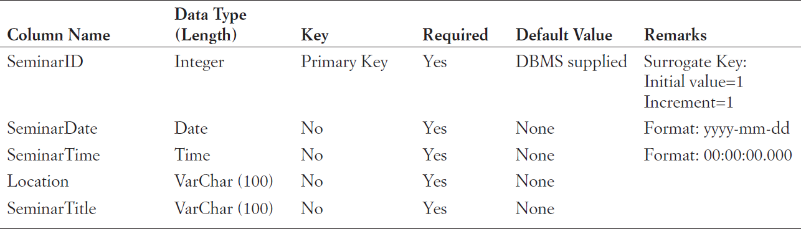
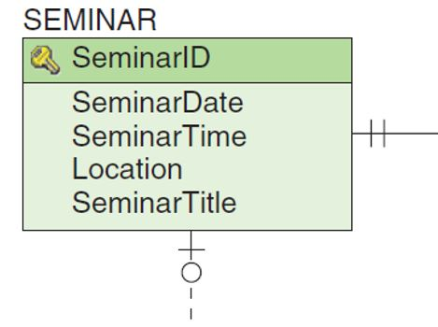
HSD Column Property Specifications SEMINAR
SEMINAR
Figures 5-26 & 5-28: Heather Sweeney Designs Column Specifications
Notes:
교과서 그림 4-21 (p. 249)

Slide 44
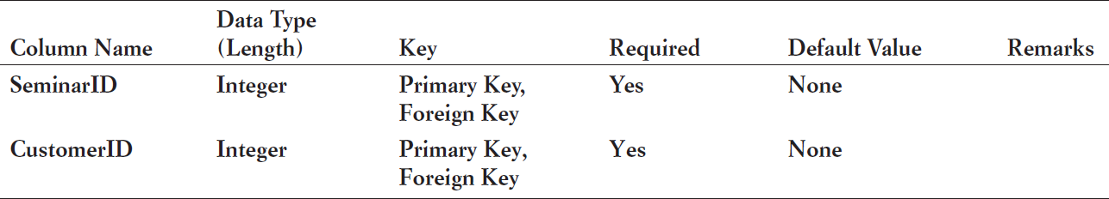
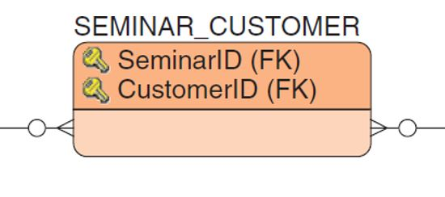
HSD Column Property Specifications SEMINAR_CUSTOMER
SEMINAR_CUSTOMER
One N:M relationship exists between SEMINAR and CUSTOMER.
To represent it, we create an intersection table, which we name SEMINAR_CUSTOMER
Its columns are the keys of the two tables involved in the N:M relationship.
Figures 5-26 & 5-28: Heather Sweeney Designs Column Specifications

Slide 45
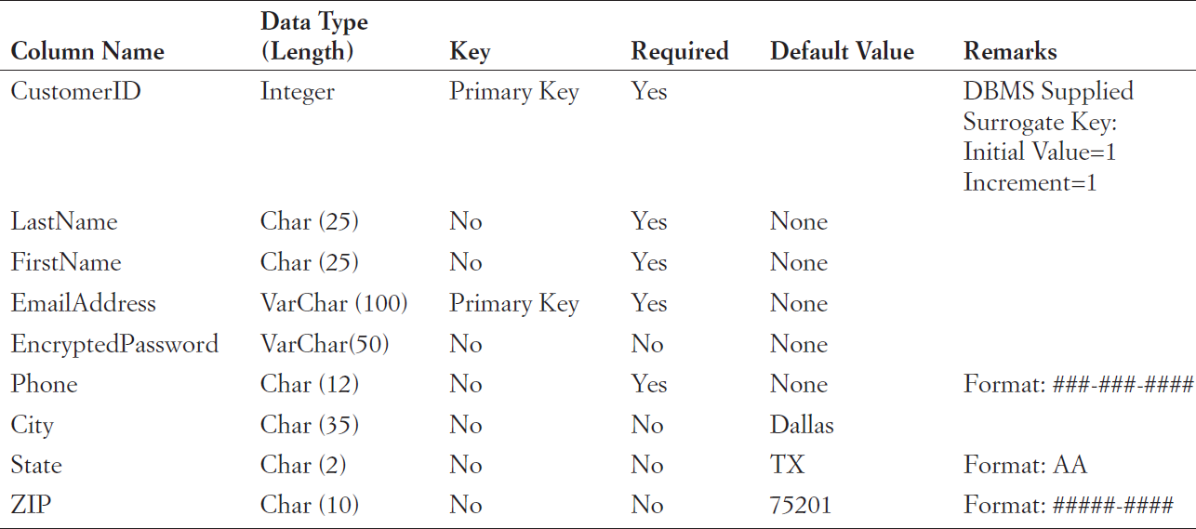
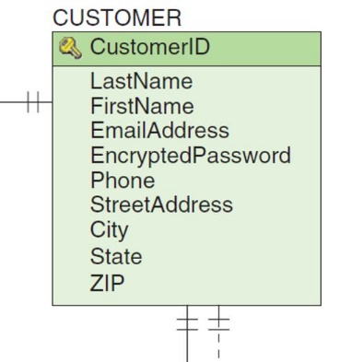
HSD Column Property Specifications CUSTOMER
CUSTOMER
Figures 5-26 & 5-28: Heather Sweeney Designs Column Specifications

Slide 46
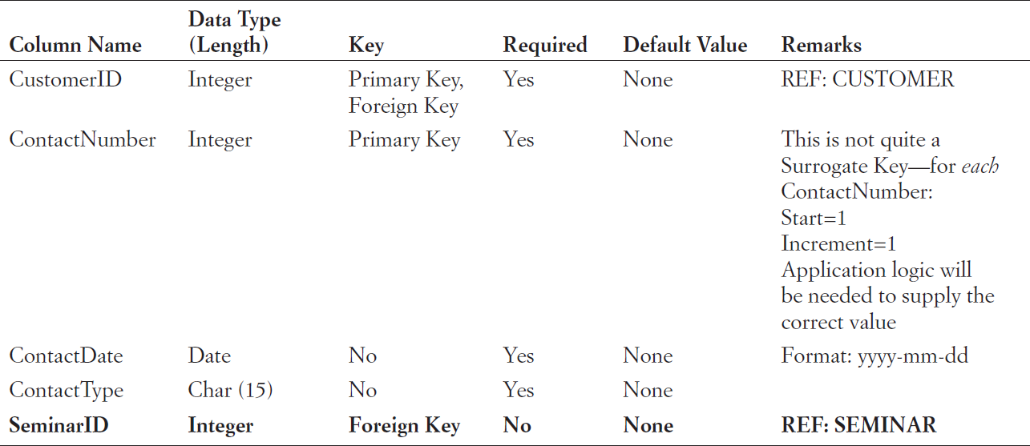
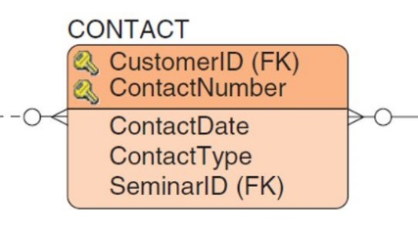
HSD Column Property Specifications CONTACT
CONTACT
Figures 5-26 & 5-28: Heather Sweeney Designs Column Specifications

Slide 47
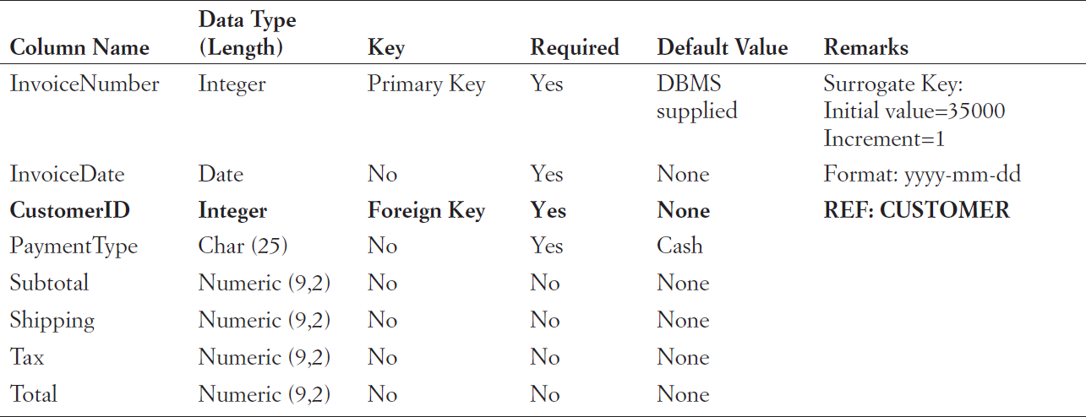
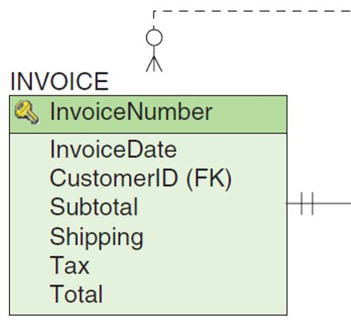
HSD Column Property Specifications INVOICE
INVOICE
Figures 5-26 & 5-28: Heather Sweeney Designs Column Specifications

Slide 48
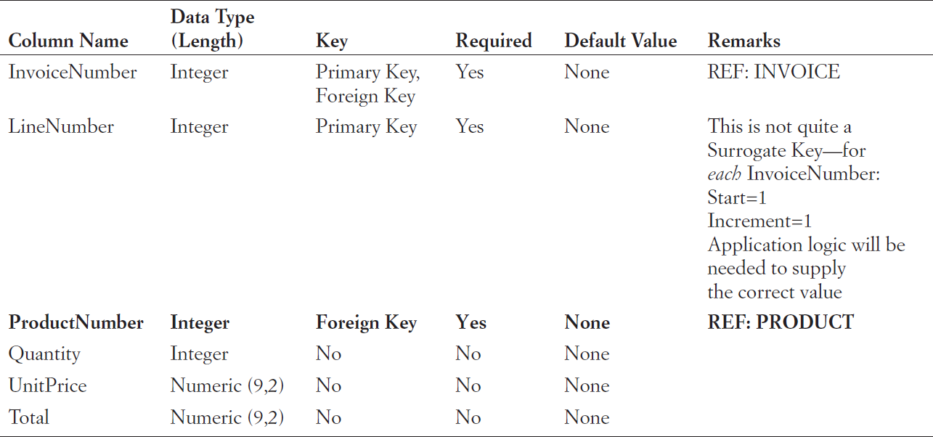
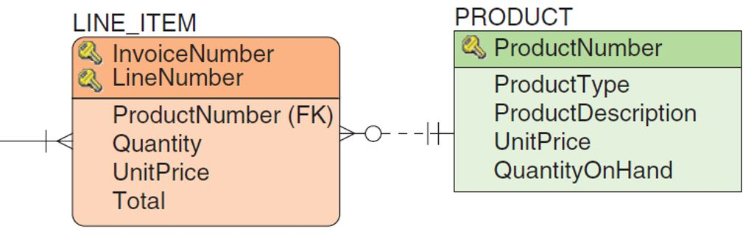
HSD Column Property Specifications LINE_ITEM
LINE_ITEM
Figures 5-26 & 5-28: Heather Sweeney Designs Column Specifications

Slide 49
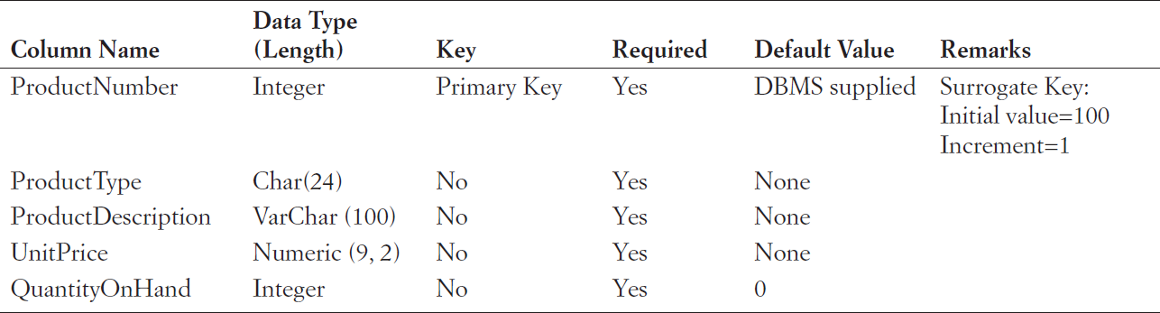
HSD Column Property Specifications PRODUCT
PRODUCT
Figures 5-26 & 5-28: Heather Sweeney Designs Column Specifications

Slide 50
Heather Sweeney Designs: Database Design
Figure 5-27: Database Design for Heather Sweeney Designs

Slide 51
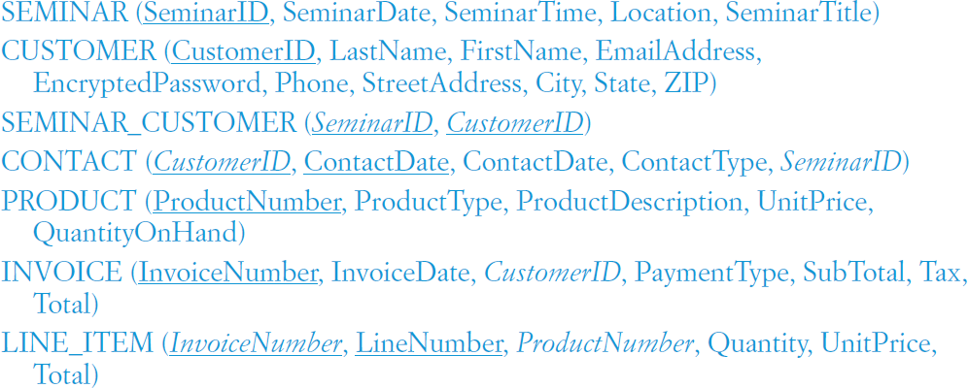
Heather Sweeney Designs: Database Design Schema

Slide 52
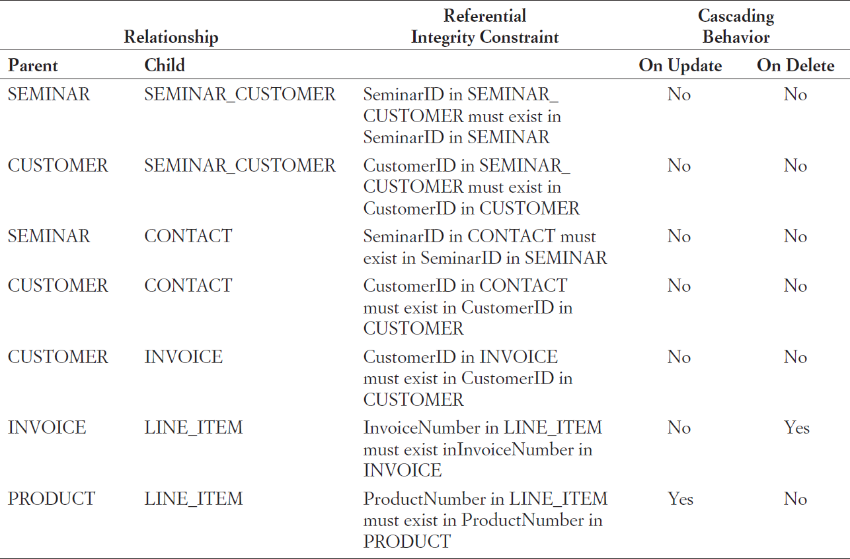
Heather Sweeney Designs: Referential Integrity Constraints
SeminarID is a surrogate key, and
An unchanging value, so no cascading update behavior will be necessary for any of the relationships that it carries.
We decide that neither seminars nor customers are ever deleted from the database
Heather never cancels a seminar, even if no customers show up, and once Heather has a customer record she never lets go of it!
Figure 5-29: Referential Integrity Constraint Enforcement for Heather Sweeney Designs
Notes:
Cascading Behavior: Parent를 대상으로 기술함. 그 이유는 종속적이지 않고 독립적이기 때문임. 종속적인 Child는 독립적인 Parent의 존재성에 그 존재가 결정되기 때문에 따로 기술할 필요가 없음. Parent가 없어지면 종속된 Child도 당연히 없어져야 함.

Slide 53
Heather Sweeney Designs: Referential Integrity Constraints
The deletion of an INVOICE will cause
the deletion of related LINE_ITEMs.
InvoiceNumber is a surrogate key so no cascading update behavior will be necessary
An attempt to delete a PRODUCT
that is related to one or more LINE_ITEMs will fail
cascading the deletion here would cause LINE_ITEMs to disappear out of ORDERs, a situation that cannot be allowed.
Figure 5-29: Referential Integrity Constraint Enforcement for Heather Sweeney Designs
Notes:
Cascading Behavior: Parent를 대상으로 기술함. 그 이유는 종속적이지 않고 독립적이기 때문임. 종속적인 Child는 독립적인 Parent의 존재성에 그 존재가 결정되기 때문에 따로 기술할 필요가 없음. Parent가 없어지면 종속된 Child도 당연히 없어져야 함.

Slide 54
Database Design
DAVID M. KROENKE and DAVID J. AUER
DATABASE CONCEPTS, 7th Edition, Global Edition
End of Presentation on Chapter Five

